Slide 1


Unit 3: Lesson 12
Danger or thrill

Slide 2
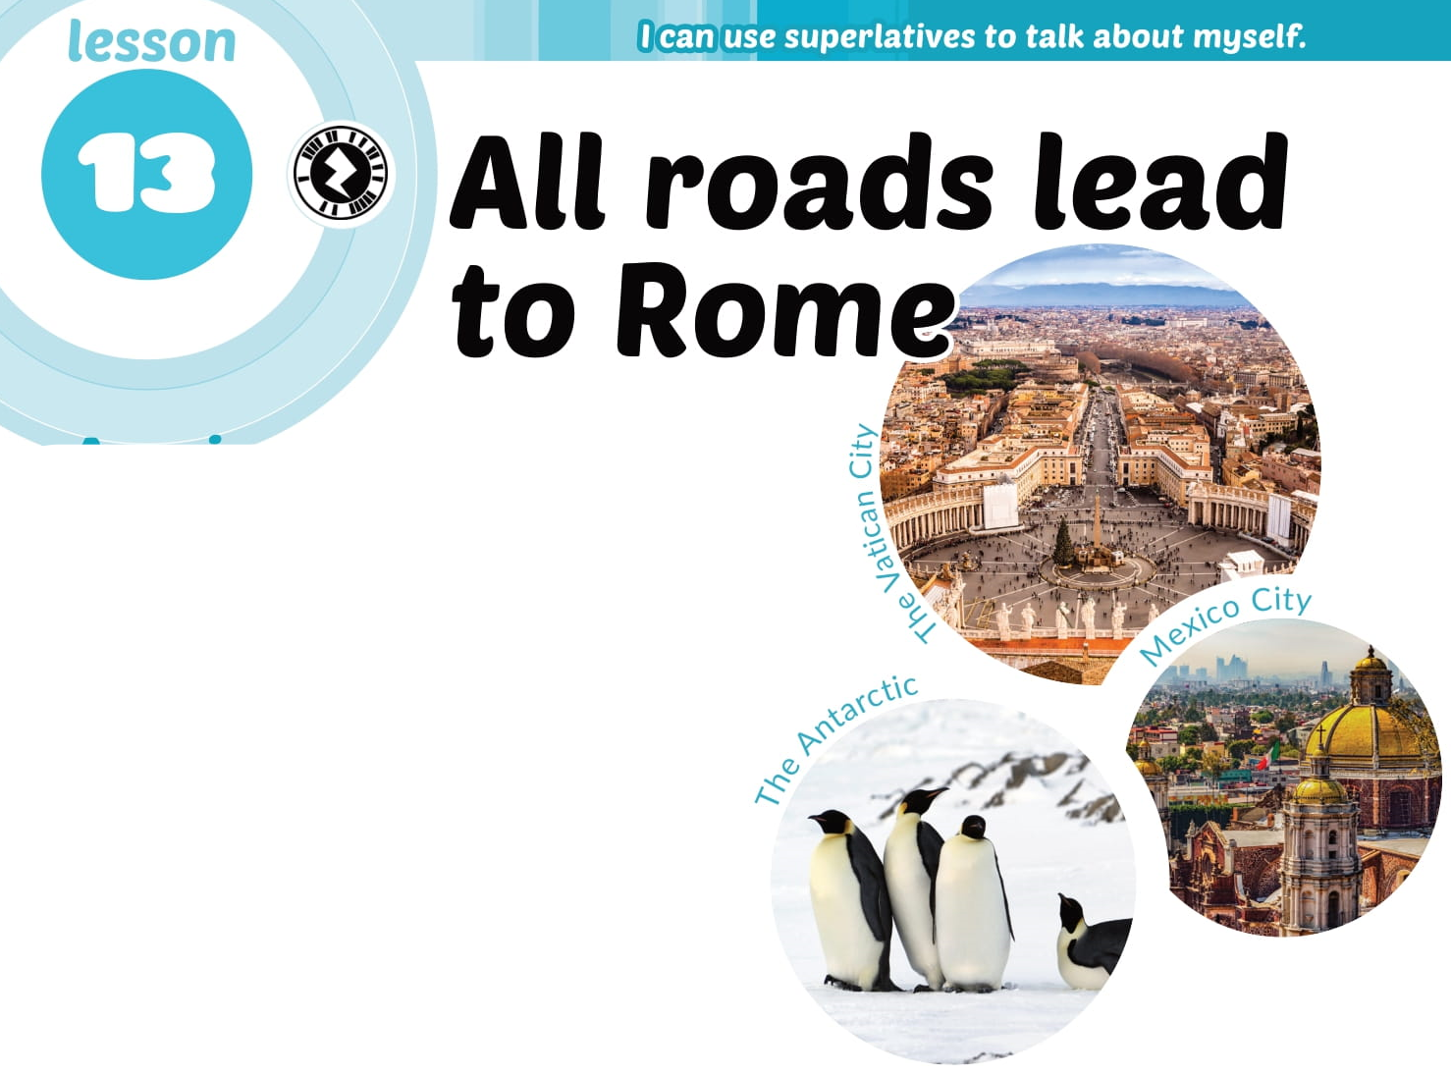

Slide 3
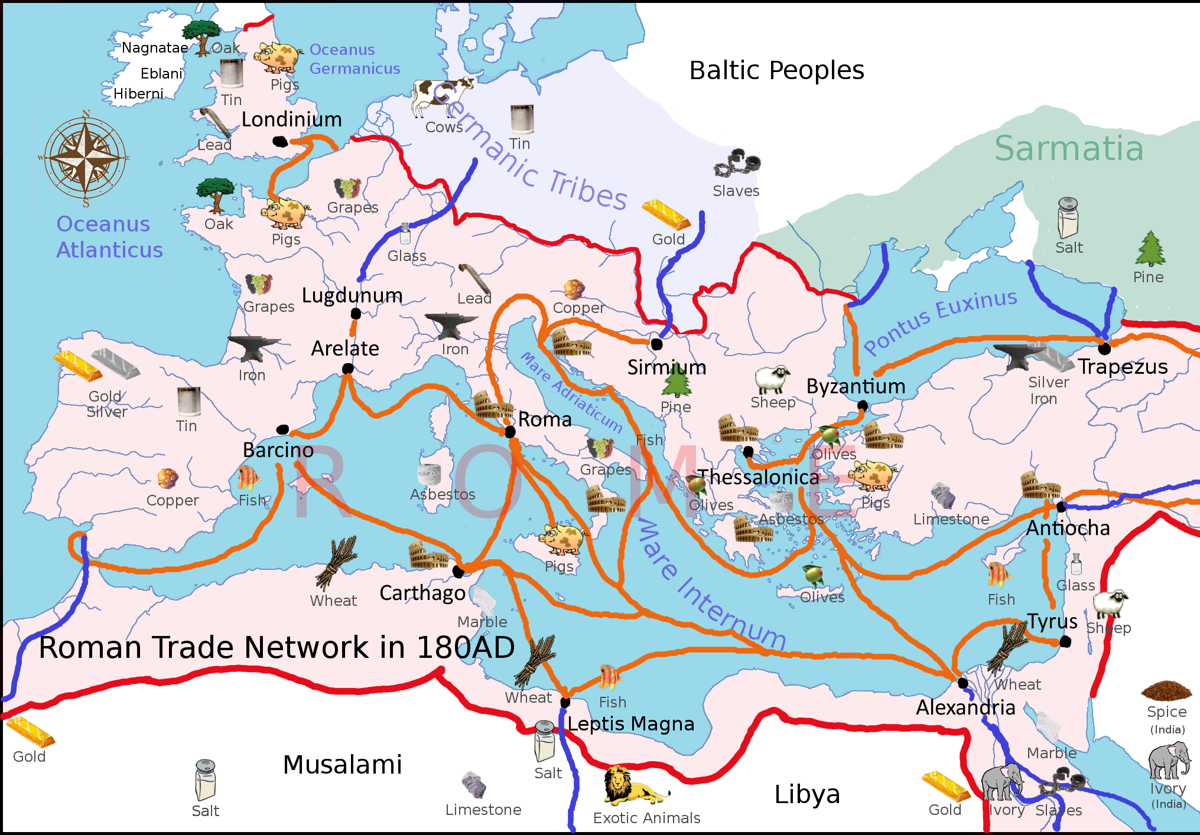


Slide 4
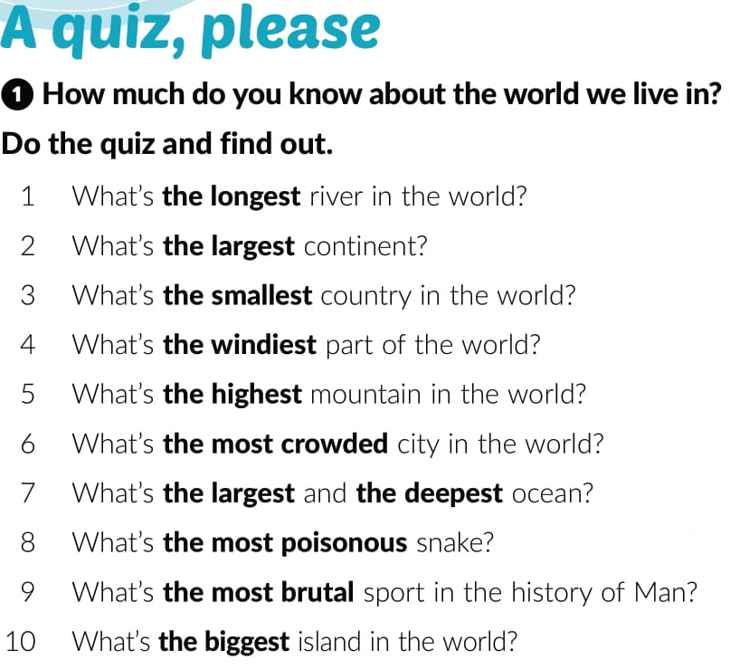
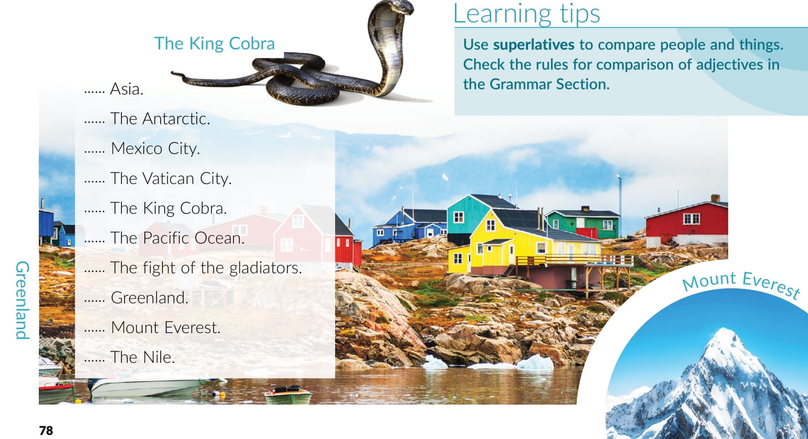
2
4
6
3
8
7
9
10
5
1

Slide 5
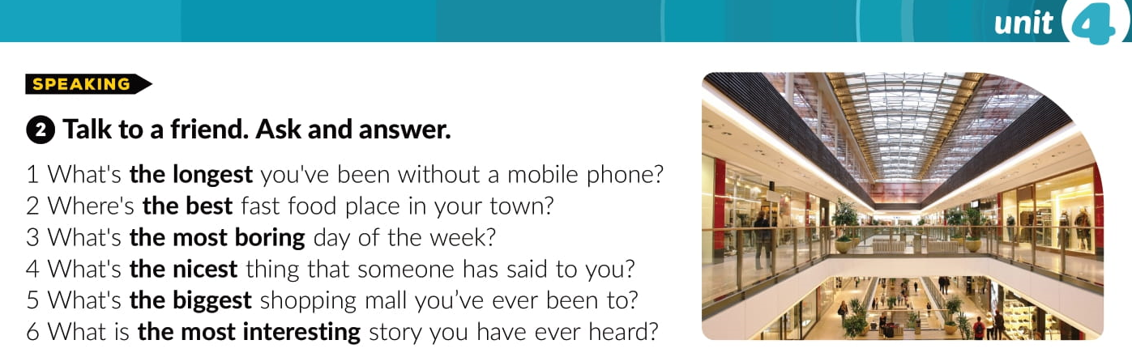

Slide 6
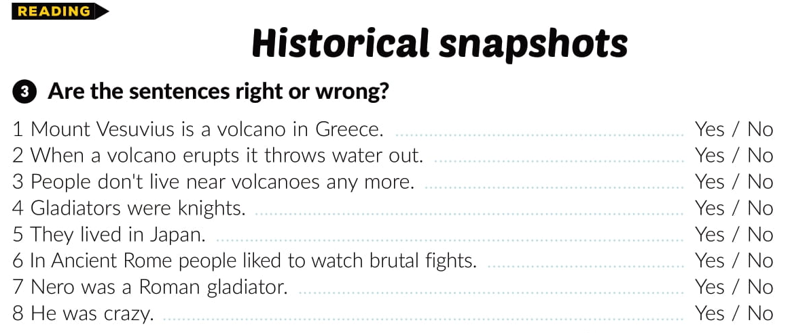

Slide 7
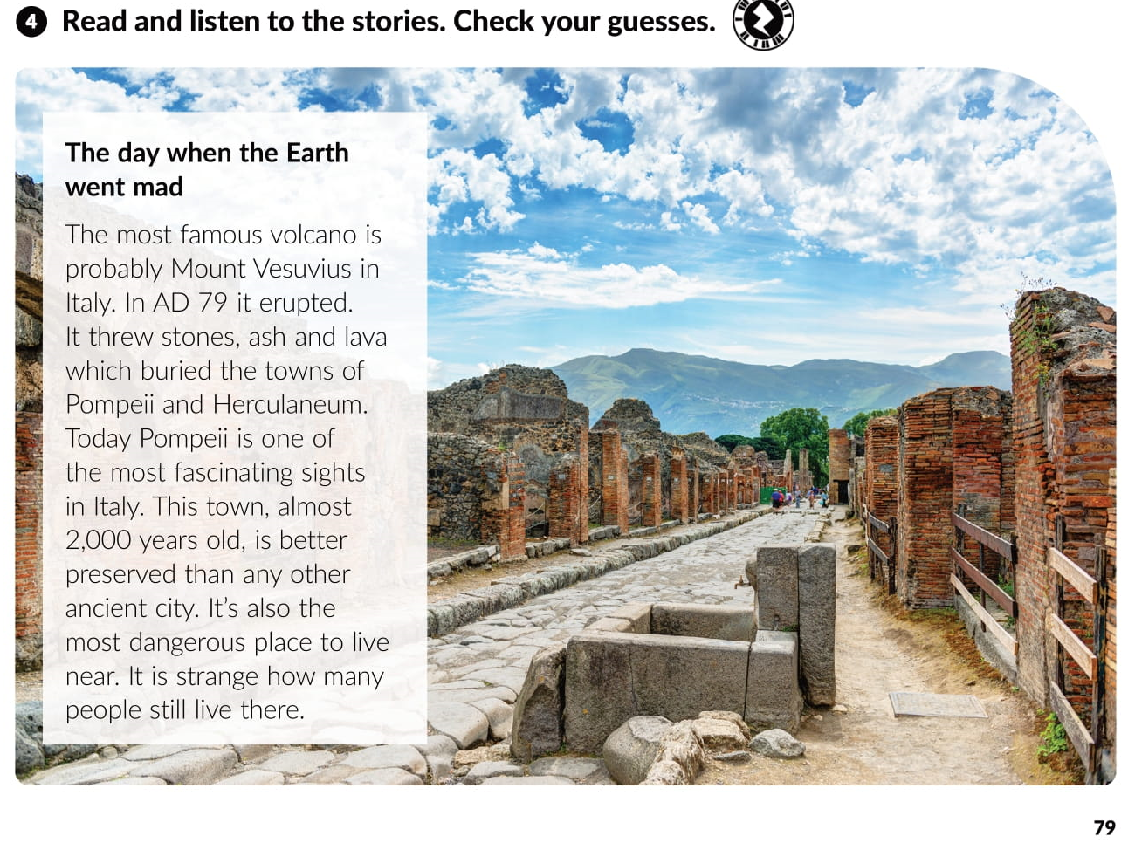

https://www.e-sfera.hr/dodatni-digitalni-sadrzaji/18299b02-90a3-40e1-abee-e590e64c1ab6/assets/audio/19-track_19.mp3

Slide 8
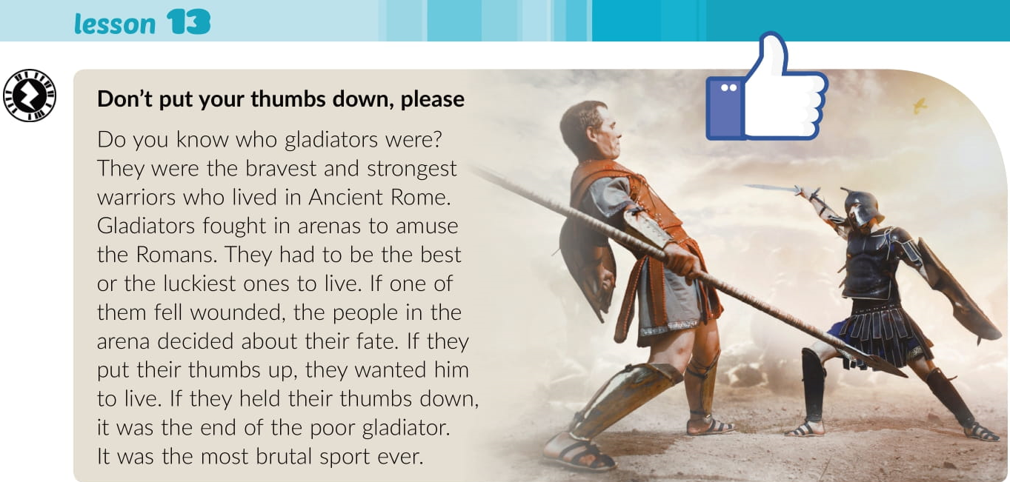
https://www.e-sfera.hr/dodatni-digitalni-sadrzaji/18299b02-90a3-40e1-abee-e590e64c1ab6/assets/audio/20-track_20.mp3

Slide 9
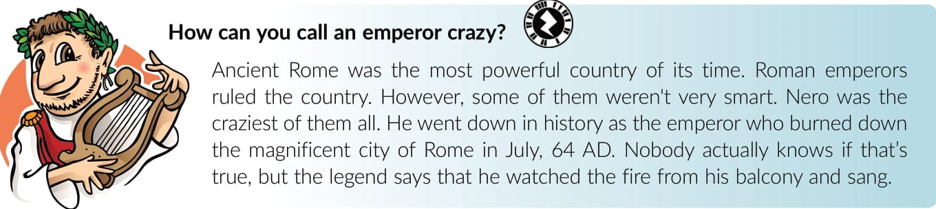
https://www.e-sfera.hr/dodatni-digitalni-sadrzaji/18299b02-90a3-40e1-abee-e590e64c1ab6/assets/audio/27__lesson_13___how_can_you_call_an_emperor_crazy.mp3

Slide 10
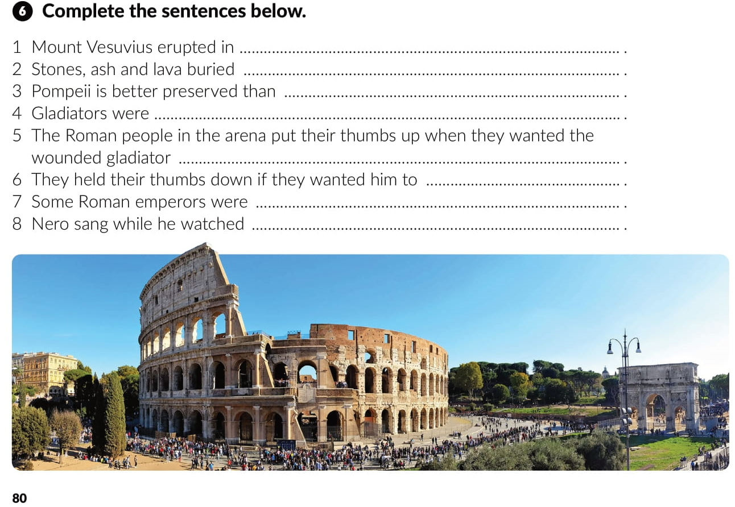
79 AD
the towns of Pompei and Herculaneum
any other ancient city
the bravest and strongest warriors who lived in Ancient Rome
to live
die
crazy
fire in the city of Rome

Slide 11
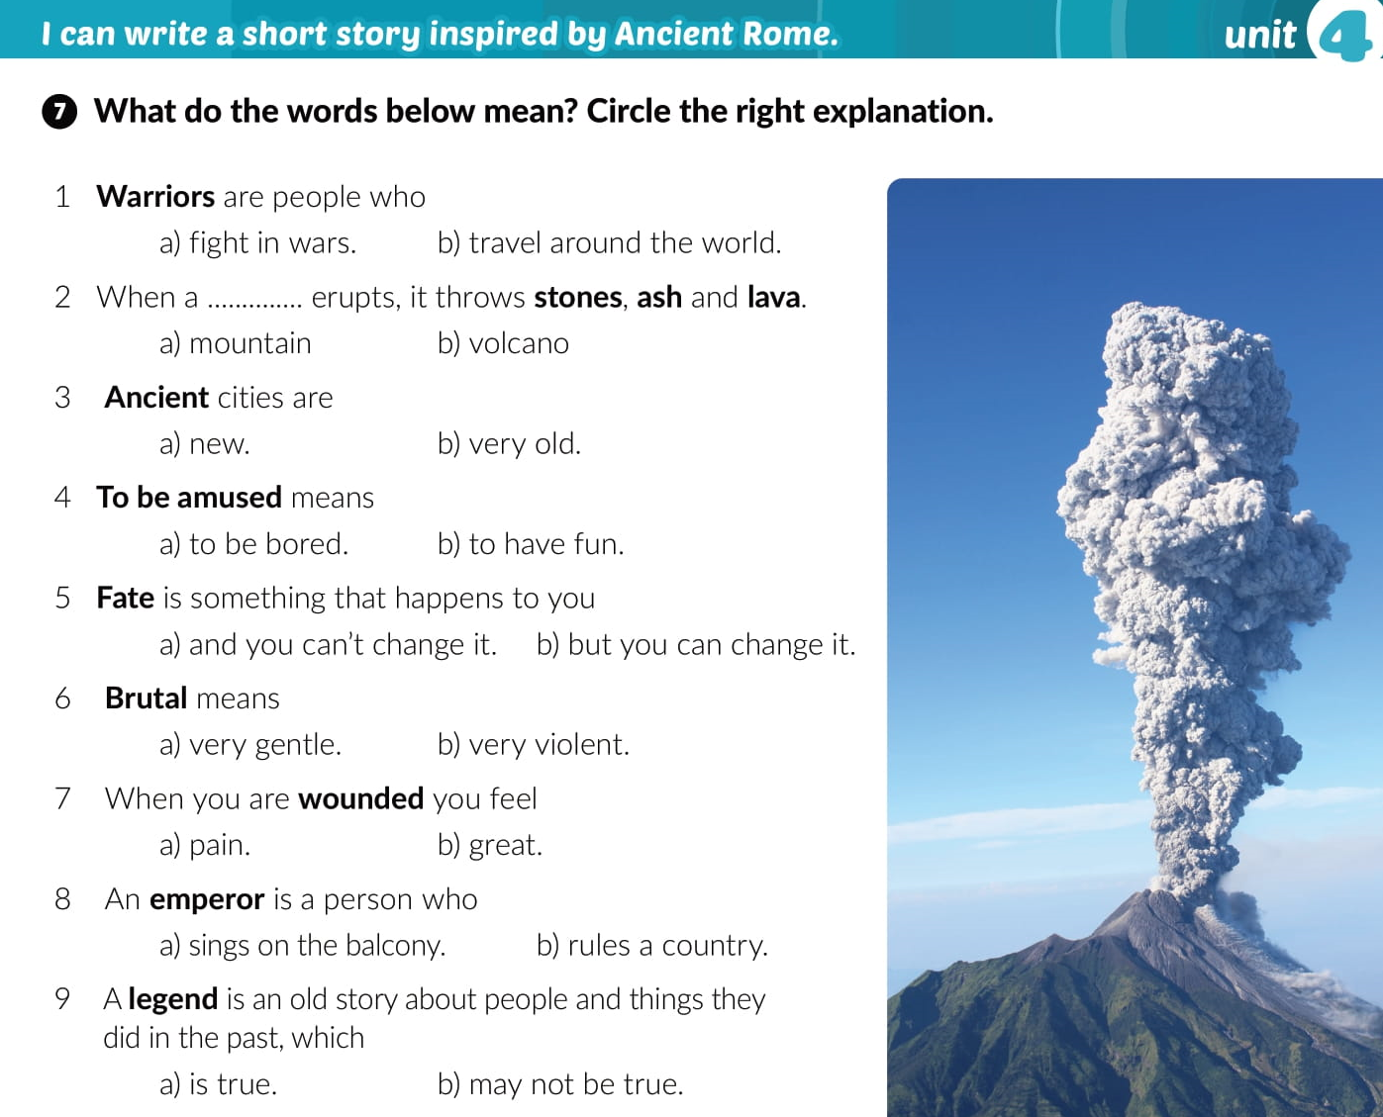

Slide 12
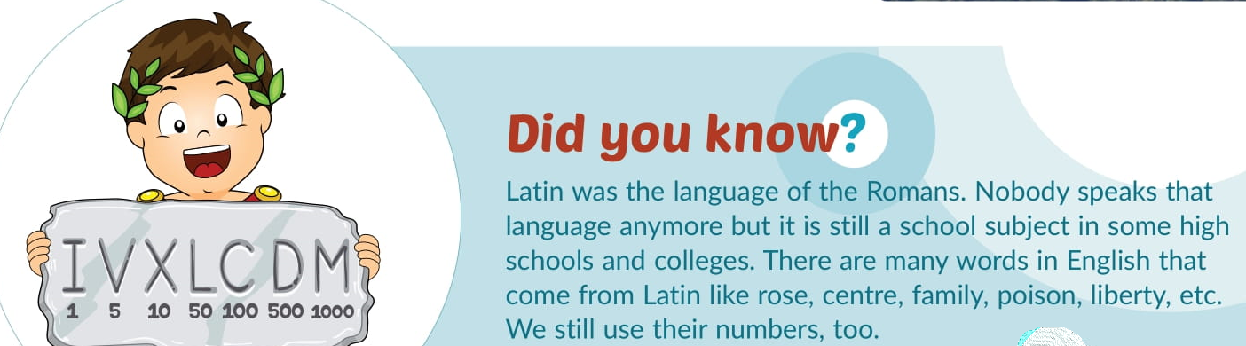

Slide 13
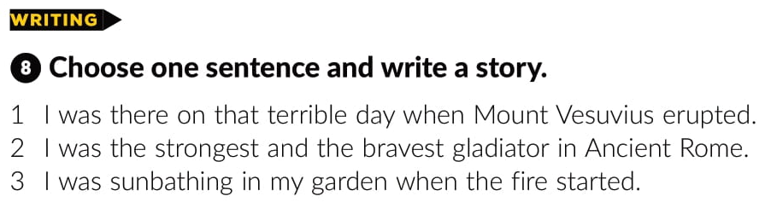


Slide 14
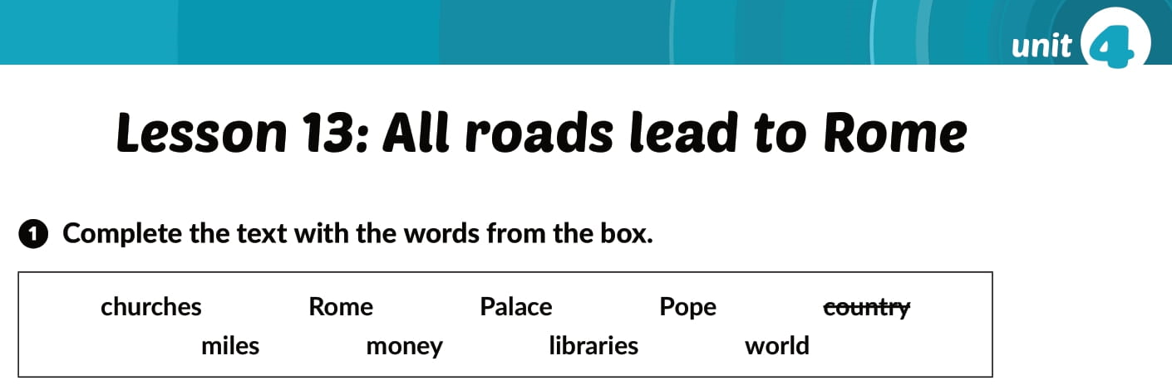
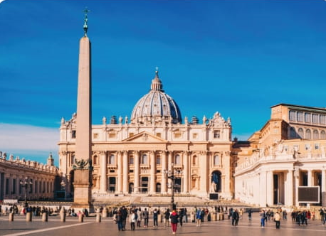
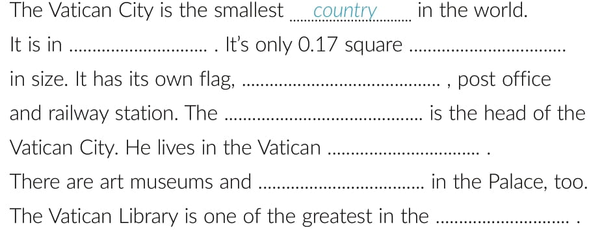
workbook p 61.
Rome
miles
money
Pope
Palace
libraries
world
churches

Slide 15
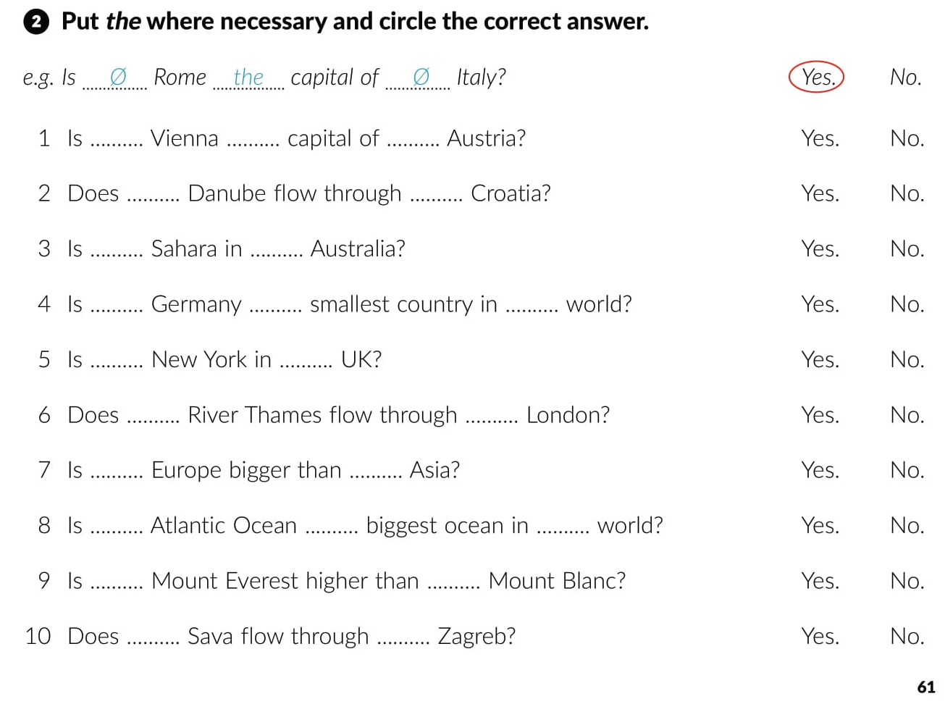
Ø
the
Ø
the
Ø
the
Ø
Ø
the
the
Ø
the
the
Ø
Ø
Ø
the
the
the
Ø
Ø
the
Ø

Slide 16
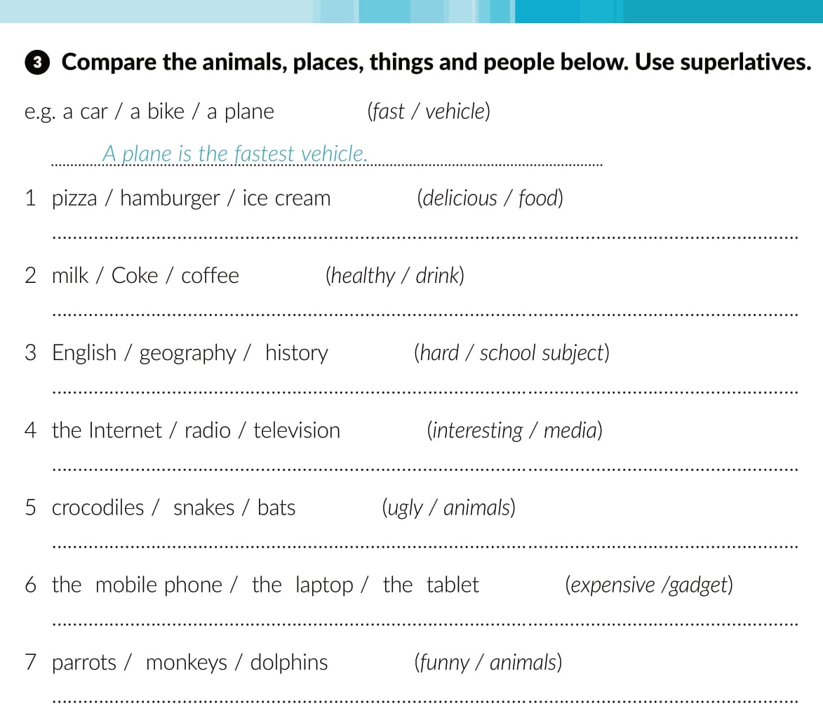
….. is the most delicious food.
… is the healthiest drink.
… is the hardest school subject.
… is the most interesting media
… are the ugliest animals.
… is the most expensive gadget.
… are the funniest animals.

Slide 17
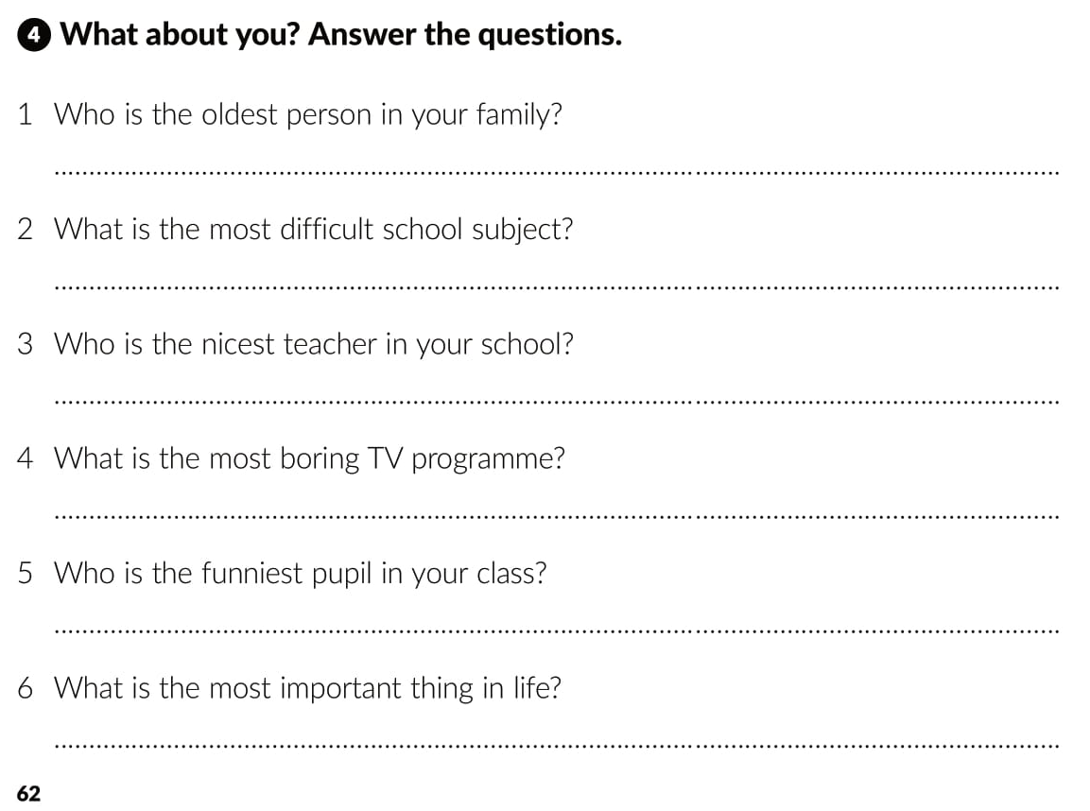
The oldest person in my family is…
The most difficult school subject is…
The nicest teacher in my school is…
The most boring TV programme is…
The funniest pupis in my class is…
The most important thing in life is…

Slide 18
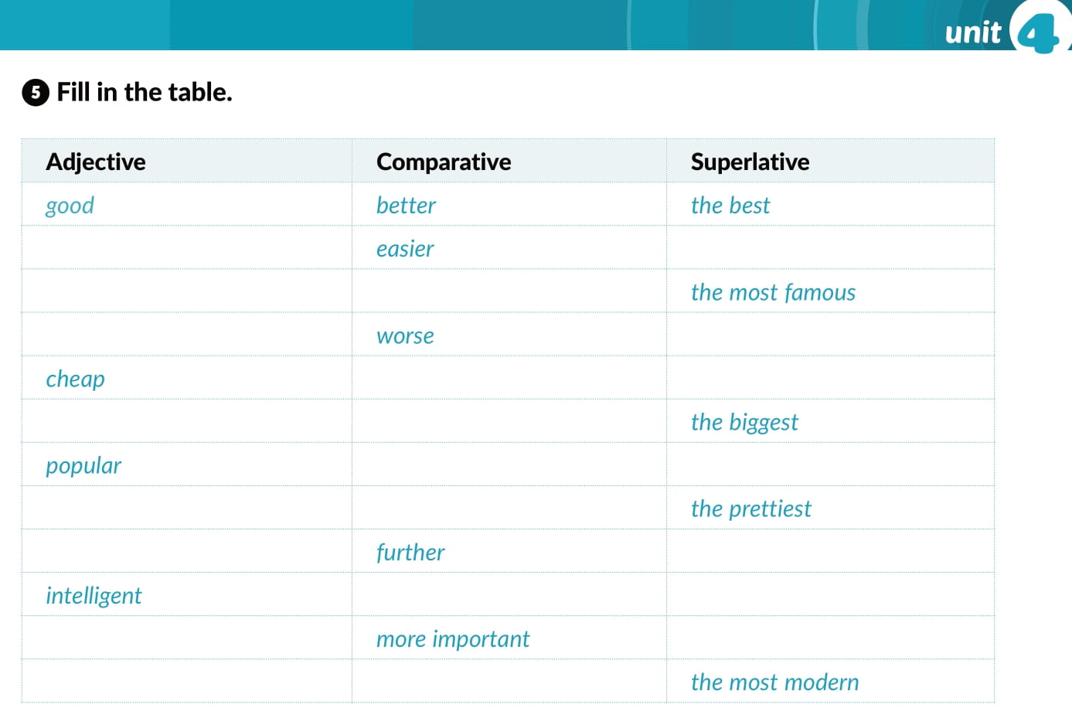
easy
the easiest
famous
more famous
bad
the worst
cheaper
the cheapest
big
bigger
more popular
the most popular
pretty
prettier
far
the furthest
more intelligent
the most intelligent
important
the most important
modern
more modern

Slide 19
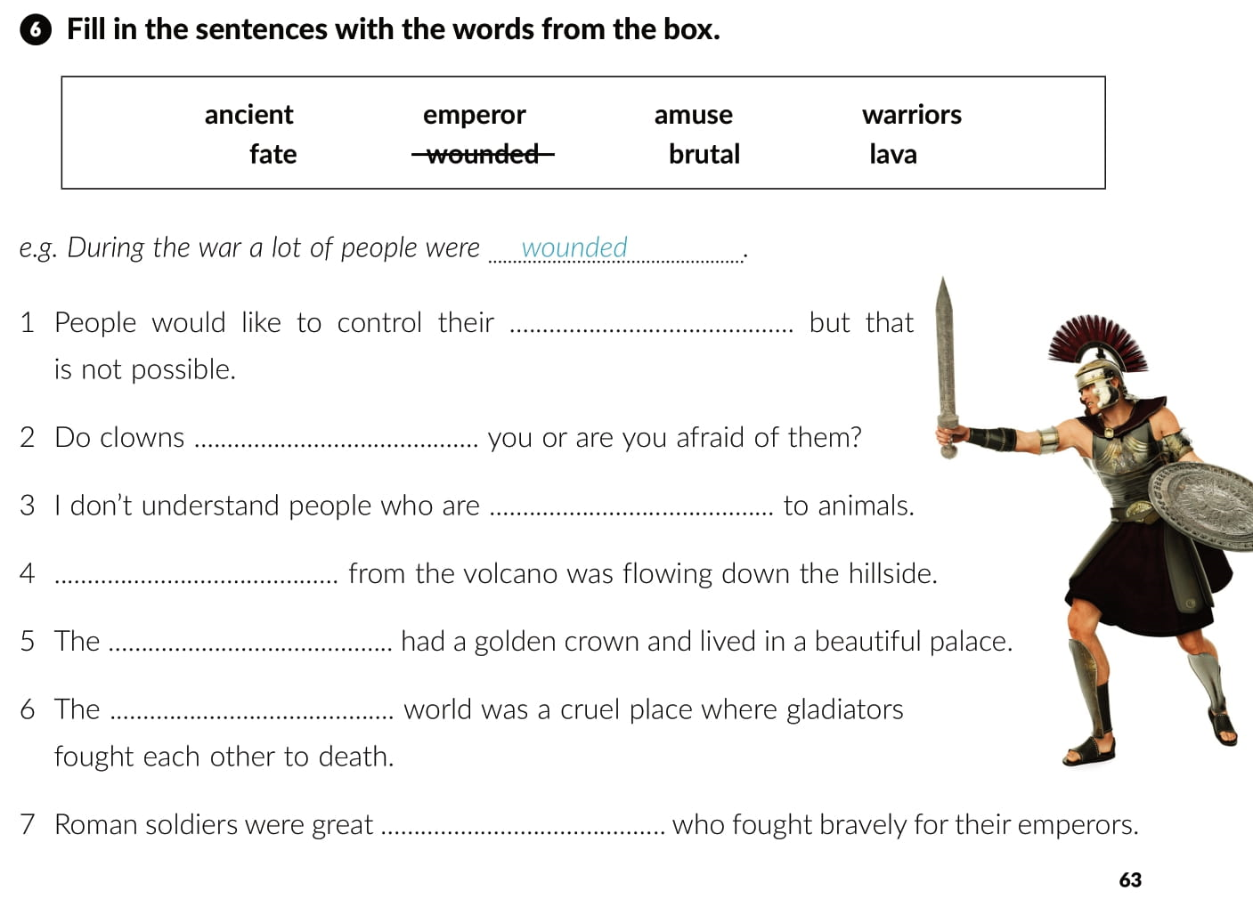
fate
amuse
brutal
Lava
emperor
ancient
warriors

Slide 20
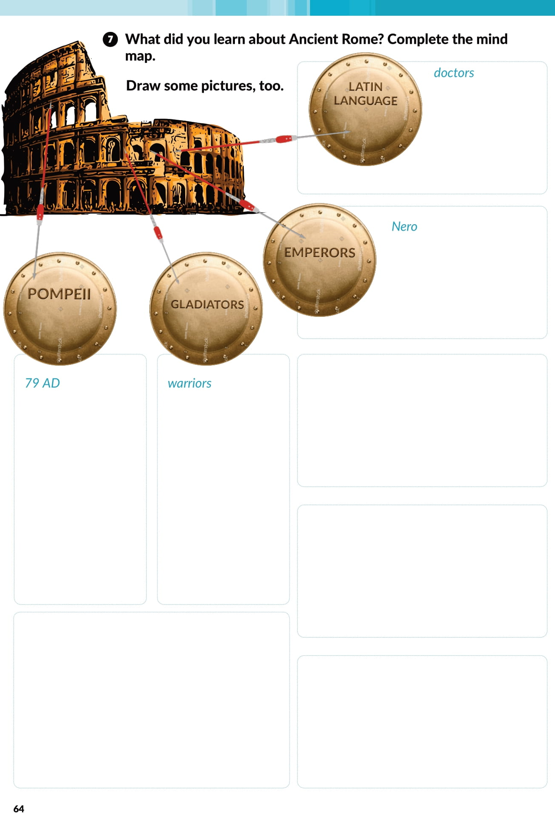

Slide 21

PLAY AND LEARN!
https://www.e-sfera.hr/dodatni-digitalni-sadrzaji/18299b02-90a3-40e1-abee-e590e64c1ab6/

